Slide 1
Introduction to analysing data about crime using R
Dr Ana Morales-Gomez
Manchester
4-5 February 2020

Slide 2
Housekeeping
Toilets
Fire alarms

Slide 3
Programme

Slide 4

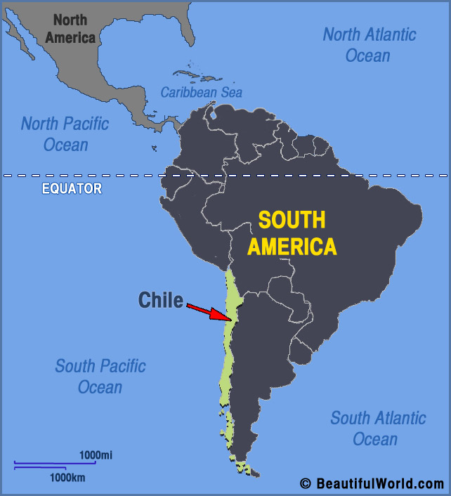
Who am I?

Slide 5
The Crime data collection at the UK Data Service
Dr Ana Morales-Gomez
Introduction to analysing data about crime using R
Manchester
4-5 February 2020

Slide 6

What is the UK Data Service?
A comprehensive resource funded by the ESRC
A single point of access to a wide range of secondary social science data
Support, training and guidance
Notes:
The UK Data Service is a comprehensive resource funded by the ESRC. It is made up of the former services ESDS, Census.ac.uk, and the Secure Data Service.
We provide a single point of access to a wide range of social science data
As well as the data, we also provide support, training and guidance

Slide 7
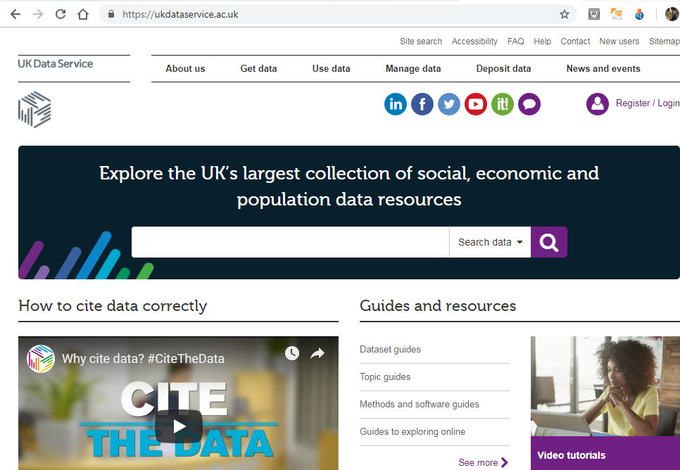
ukdataservice.ac.uk

Slide 8
What data do we hold?
Surveys
Longitudinal
International
Large-scale government funded UK and cross-national surveys
Major UK surveys following individuals over time
Multi-nation aggregate databanks and survey data
Census
Business
Qualitative
Census data 1971 – 2011
Microdata and administrative data
Range of multimedia qualitative data sources
Notes:
Next we are going to look at the different types of data help within the Service. The main types are national surveys, longitudinal studies, international databanks, the UK census data, business micro-data and qualitative data. We also host datasets produced by researchers during the courses of their research. In fact if you are funded by the ESRC, you are obliged to offer any data you produce to the UK Data Service. Many big funders now ask grantees to make the data they produce open and the UK Data Service is one platform you can use for this.

Slide 9
Other resources and support
Helpdesk
Webinars & Workshops
Teaching Resources
Guides & Video tutorials
Training and e-books
Individual support by e-mail
See events pages
Topic
Dataset
Methods and software
Worksheets and teaching ideas

Slide 10
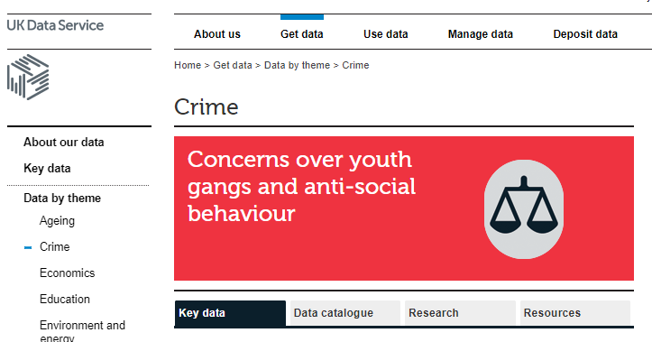
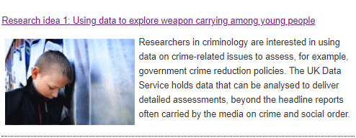
UKDS Crime data collection
Data by theme: Crime
List of Key datasets
Examples on how to find data
Case studies
Teaching and case studies of data analysis on crime
Notes:
Crime' encompasses a wide range of issues that lie within the remit of several academic disciplines, including sociology, psychology, law and economics

Slide 11
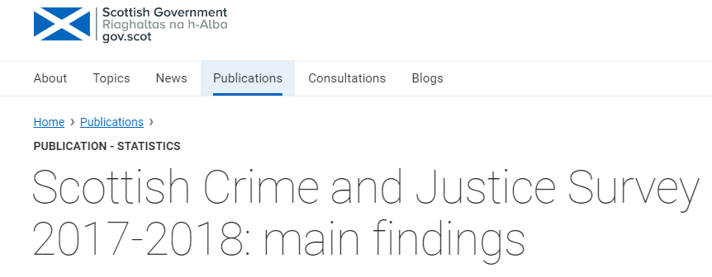
UKDS Crime data collection (2)
Data collected by Research Centres and Government Organisations
Anonymised survey data at the individual level
Heavily used by academics, Government organisations and research community
Some of them used to obtain official statistics, i.e. CSEW, SCJS

Slide 12
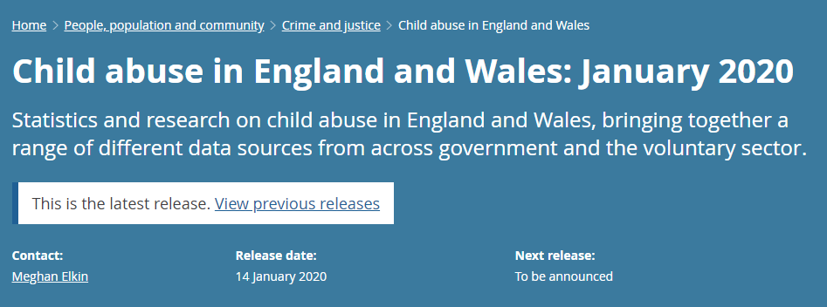
Crime Survey for England and Wales (CSEW)
https://www.ons.gov.uk/peoplepopulationandcommunity/crimeandjustice/bulletins/childabuseinenglandandwales/january2020

Slide 13
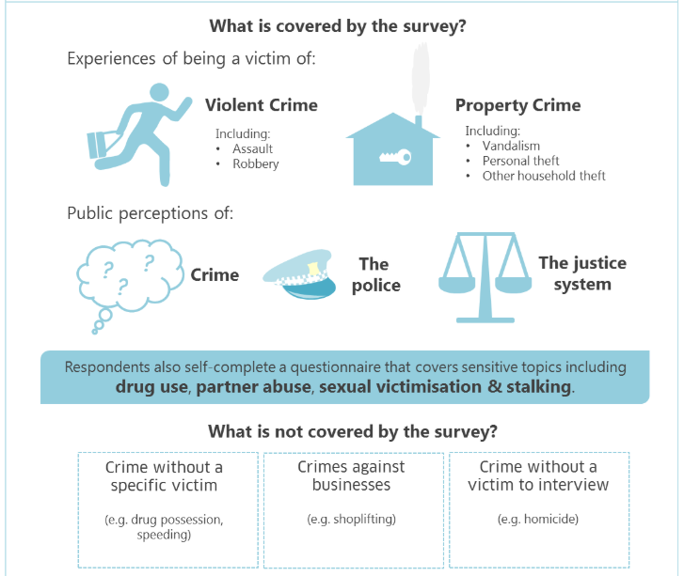
Scottish Crime and Justice Survey SCJS
https://www2.gov.scot/Topics/Statistics/Browse/Crime-Justice/crime-and-justice-survey

Slide 14
Key data on crime
Repeated Cross-sectional data:
Crime Survey for England and Wales (CSEW)
Scottish Crime and Justice Survey (SCJS)
Commercial Victimisation Survey (CVS)
Cross-Sectional Data
Arrestee Survey, 2003-2006
Conflicts and Violence in Prison, 1998-2000 (qualitative)
Longitudinal
Edinburgh Study of Youth Transitions and Crime : Waves One to Four, 1997-2001 (not full collection)
Offenders Index Cohort Data, 1953-1997 (Cohort data)
Notes:
The Commercial Victimisation Survey (CVS) provides a source of information on crime and crime-related issues as they affect businesses in England and Wales.

Slide 15
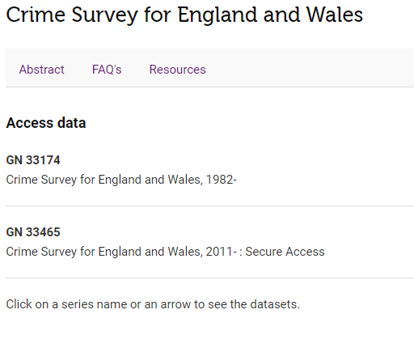
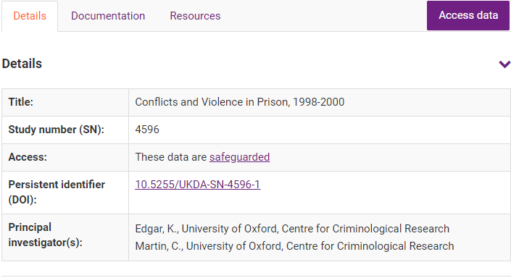
Access
Three levels of access
Safeguarded Data
Special Licence (not all series of data)
Secure Access
How to access data held by the UKDS?

Slide 16
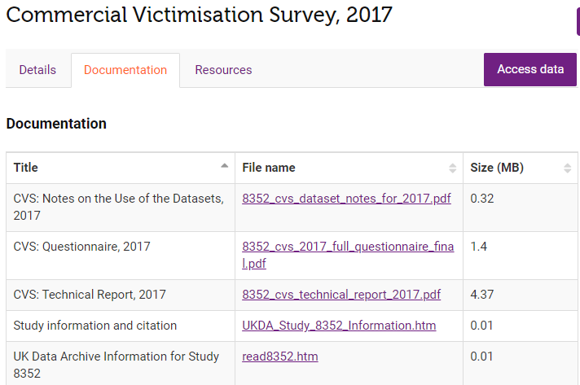
Documentation

Slide 17
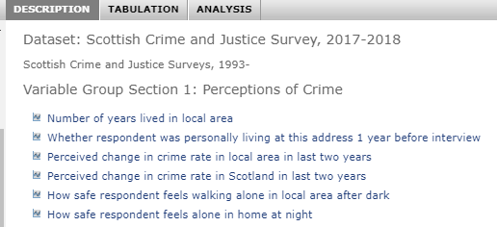

Where/how to analyse this data?
Online
Nesstar
Directly on your computer
Excel
SPSS
Stata
SAS
R or R Studio

Slide 18
Ana Morales-Gomez
ana.morales@Manchester.ac.uk

